Slide 1
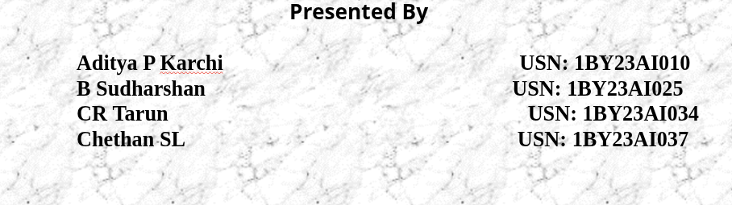
Mini Project Presentation Review –1
Beyond the Bet: Unveiling the Economic and Addictive Traps of Manipulated Odds in India's Online Betting Landscape.
Presented By
Aditya P Karchi USN: 1BY23AI010 B Sudharshan USN: 1BY23AI025 CR Tarun USN: 1BY23AI034 Chethan SL USN: 1BY23AI037
Under the guidance of
Dr. Manoj HM
Associate Professor
15-11-2025
1

Slide 2
INTRODUCTION
The online betting industry in India is growing rapidly. However, it is difficult to determine the exact size and value of the market for 2025 because a large portion of it operates illegally with worth over ₹3 trillion (about $40 billion) each year. The growth in online gaming has been significant over the past ten years, driven by digital access, smartphone use, and the fun of gaming. The COVID-19 pandemic also led to an increase in online betting, as more people were online and aware of these platforms.The core problem this presentation addresses is how betting companies can manipulate odds and design unfair platforms, creating a significant disadvantage for users and leading to inflated profits for the companies. This investigation aims to unveil these manipulative practices to better protect consumers in a global market that is projected to grow to over $57 billion.
15-11-2025
2

Slide 3
Problem Statement
The main problem this project looks at is how betting companies can manipulate odds and design their platforms in ways that are unfair to users, that can lead to bigger profits for the companies and put consumers at a disadvantage.
15-11-2025
3

Slide 4
OBJECTIVES
To build an informational website or platform that educates the public on the mechanics of betting odds, the risks of the unregulated market, and how data can reveal unfair practices.
Establish a "True Odds" Baseline: To use the validated prediction model to generate unbiased, data-driven probabilities for race outcomes, establishing a "true odds" benchmark for fair betting.
To develop and validate a high-accuracy machine learning framework capable of predicting horse racing outcomes, and to leverage this model to systematically identify and expose manipulated odds and unfair practices within the online betting market, thereby promoting consumer protection.
15-11-2025
4

Slide 5
Existing System :Literature Survey
Ref | Project Title | Author(s) | Year | Technologies / Methods Used | Limitations & Gaps
[1] | Fair and easy: the effect of perceived fairness, effort expectancy and user experience on online slot machine gambling intention | J. Konietzny, A. Caruana | 2018 | Survey-based analysis, statistical modeling | Focused only on slot machines; lacks AI or digital intervention studies.
[2] | The structural characteristics of online sports betting | J. Torrance | 2024 | Behavioral analysis, gambling psychology frameworks | Descriptive only; no predictive or AI/ML models applied.
15-11-2025
5

Slide 6
[3] | Identifying online sports betting motivations associated with betting intention | H. Song, K. K. Byon, P. M. Pedersen | 2024 (pre-pub online 2025) | Quantitative surveys, regression analysis | Links motivations with intentions but lacks long-term or tech-driven insights.
[4] | AI-based betting anomaly detection system to ensure ... | C. Kim et al. | 2024 | Artificial Intelligence, anomaly detection, machine learning | Technical focus; limited to anomaly detection; fairness/ethics not addressed.
[5] | Youth Sports Betting and Problem Gambling | F. M. Daniel | 2024 | Literature review, global data synthesis | Review-only; lacks new experimental or AI-driven interventions.

Slide 7
[6] | Auditing Fairness by Betting | B. Chugg | 2023 | Statistical auditing, fairness in ML | Theoretical; not tested on large-scale real betting platforms.
[7] | How structural changes in online gambling are shaping the ... | N. Hing et al. | 2022 | Policy review, structural gambling analysis | Focuses on market/regulatory aspects; lacks technical prevention measures.
[8] | Favorite-longshot bias | Wikipedia | 2024 (accessed 2025) | General reference, statistical gambling bias | Informational only; no new empirical research.

Slide 8
Proposed System
Our solution is a unified framework that uses machine learning to bring transparency to the online betting market. It establishes a "fair odds" benchmark to historically analyze market manipulation and assess platform fairness.
1. Data & Preprocessing Engine :
Function: Processes and cleans the existing dataset of over 14,700 races.
Key Technology: Utilizes the SMOTE technique to correct data imbalance, ensuring unbiased analysis.
2. Predictive Modeling Core :
Function: Calculates the true, unbiased probability of winning for each horse from the historical data.
Key Technology: Powered by a Random Forest algorithm with accuracy.
Output: Generates a data-driven "Fair Odds" baseline for every race in the dataset.
3. Historical Market Odds Engine :
Function: Compiles and analyzes the historical betting odds that were offered for the races in our dataset.
Output: Creates a comparative database of the "Market Odds" that were presented to consumers.
15-11-2025
8

Slide 9
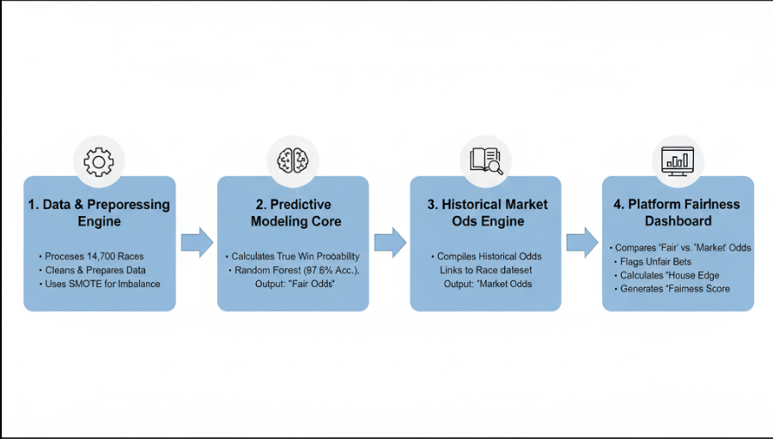
Proposed System
4. Platform Fairness Dashboard
Function: A web-based analytical tool that visualizes the historical data.
Key Features:
Directly compares our calculated "Fair Odds" vs. historical "Market Odds".
Generates a historical "Fairness Score" for different betting sites.
15-11-2025
9

Slide 10
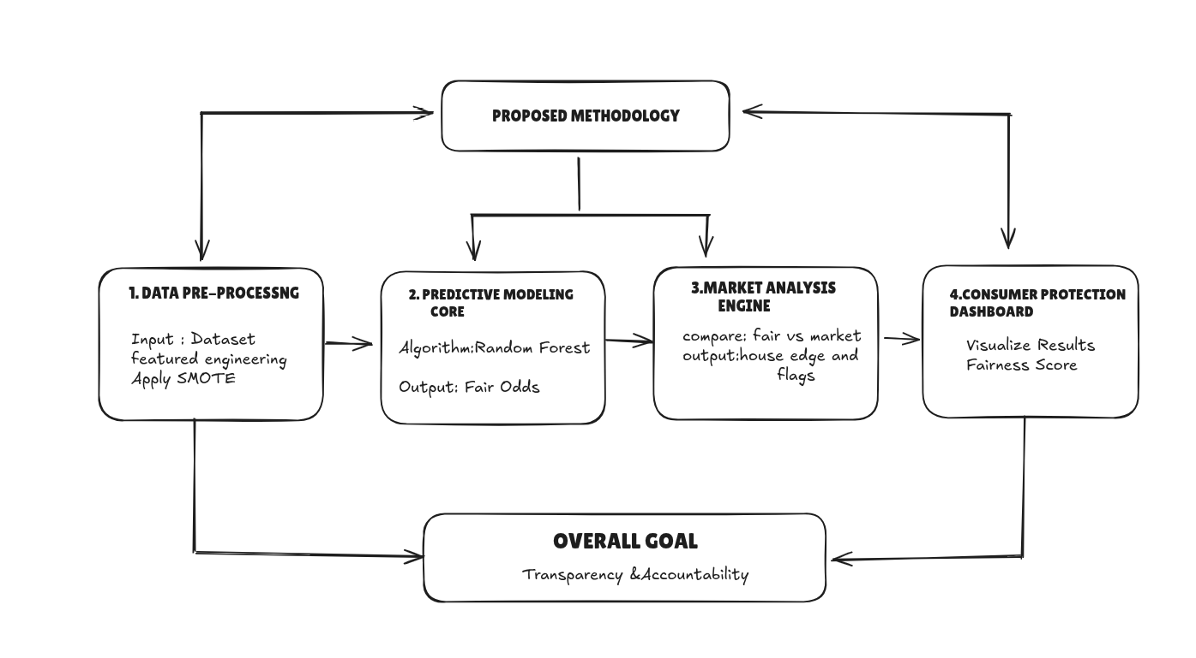
Proposed Methodology
15-11-2025
10

Slide 11
Outcome of the project
A Quantitative Analysis of Market Fairness: The system will produce a detailed report quantifying the statistical difference between the "fair odds" and the actual "market odds," effectively measuring the "house edge" and identifying instances of potential manipulation.
An Analytical Dashboard Prototype: The project will result in a proof-of-concept software dashboard that visually presents the findings, allowing users to explore the historical fairness of betting platforms.
Increased Consumer Awareness: The project's findings will serve as a powerful educational tool, raising public awareness about the hidden mathematical disadvantages and potential unfairness within the unregulated online betting industry.

Slide 12
Tools and Technologies
Programming Language:
Python: The most common and powerful language for data science, used for implementing the entire workflow.
Core Machine Learning & Data Science Libraries:
Scikit-learn: A fundamental library for implementing the machine learning models.
Random Forest (Primary Model)
Imbalanced-learn: A specialized library used to implement the SMOTE (Synthetic Minority Oversampling Technique) for handling the imbalanced dataset.
Pandas: The essential library for data manipulation, including loading, cleaning, and structuring the dataset.
NumPy: A critical library for high-performance numerical and mathematical operations on the data.
Development Environment:
Jupyter Notebook / JupyterLab / VS Code: An interactive environment ideal for data exploration, model development, and visualizing results step-by-step.

Slide 13
Tools and Technologies
These are the recommended minimum specifications for a system to efficiently handle the dataset and model training as described in the paper.
Hardware Requirements (Functional):
CPU: Multi-core processor (e.g., Intel Core i5 / AMD Ryzen 5 or better).
RAM: 8 GB minimum, 16 GB recommended for smoother data handling and model training.
Storage: 256 GB SSD (Solid State Drive) recommended for fast data loading and access times.
Software Requirements (Non-Functional):
Operating System: Windows 10/11, macOS, or any modern Linux Distribution (e.g., Ubuntu).
Core Software:
Python (Version 3.7 or newer).
Anaconda Distribution: Highly recommended as it simplifies the management of Python environments and the installation of all the necessary data science libraries listed above.

Slide 14
Applications of the Project
Market Fairness Analysis:
Provides a clear, data-driven method to study and determine if betting apps are fair or biased.
Consumer Awareness & Education:
Clearly demonstrates to users the long-term financial risks, even when games appear fair initially.
Creates public awareness about the dangers of online betting and promotes responsible choices.
Academic & Research Support:
Offers a valuable resource for researchers, educators, and students in fields like gambling studies, psychology, and consumer protection.
Policy & Regulation Support:
Delivers crucial insights for policymakers to help them draft effective laws and regulations to protect users from unfair digital betting systems.
Future Scope & Development:
Establishes a foundation that can be expanded with more advanced machine learning to detect even deeper, hidden patterns in odds and betting behavior.

Slide 15
CONCLUSION
Betting apps in India show users the dream of winning money, but in reality, they are designed in a way that the company always earns profit. Most people do not know about this hidden bias and end up losing more than they win. In this project, we collected odds, compared them with real chances, and showed through simulations how users are at a disadvantage. The system makes it simple to understand that betting apps are not fair and that awareness is very important to avoid financial and social problems. The study is small, but it can grow into bigger research and also help in making fair rules for online betting in India.

Slide 16
REFRENCES
[1] C.-B. Kim, J.-H. Park, and J.-Y. Lee, "AI-based betting anomaly detection system to ensure fairness in sports and prevent illegal gambling," Scientific Reports, vol. 14, no. 1, p. 6470, Mar. 2024. [Online]. Available: https://www.nature.com/articles/s41598-024-57195-8 .
[2] G. Elaad, J. J. Reade, and C. Singleton, "Information, prices and efficiency in an online betting market," Finance Research Letters, vol. 35, p. 101321, Jul. 2020. [Online]. Available: https://linkinghub.elsevier.com/retrieve/pii/S1544612319306440 .
[3] N. Bhanot and R. Sharma, "Mapping the Emotional and Psychological Dimensions of Fantasy Sports Betting: A Bibliometric Analysis," Journal of Gambling Issues, 2025.
[4] P. Prakash, S. Girdhar, and A. Jose, "Online Gambling Addiction: A Study among College Students of Kerala State, India," Journal of University of Shanghai for Science and Technology, vol. 16, no. 2, pp. 0-3, 2024.
[5] S. J. Avenyo, N. S. Kwashie, and J. Demuyakor, "Online sports betting in universities: Does online sports betting addictions impact the academic achievements and social relations of students?," Journal of Digital Educational Technology, vol. 4, no. 1, p. ep2402, 2024.

Slide 17
REFRENCES Contd.
[6] M. Gupta and L. Singh, "Predicting Outcomes of Horse Racing using Machine Learning," International Journal on Recent and Innovation Trends in Computing and Communication, vol. 11, no. 9, pp. 38–47, Oct. 2023.
[7] M. J. Rockloff, N. Greer, P. A. Newall, and M. J. Browne, "Sports betting incentives encourage gamblers to select the long odds: An experimental investigation using monetary rewards," Journal of Behavioral Addictions, vol. 9, no. 1, pp. 136-147, Mar. 2020.
[8] D. Forrest and I. G. McHale, "Using statistics to detect match fixing in sport," IMA Journal of Management Mathematics, vol. 30, no. 4, pp. 431–449, Oct. 2019.
[9] A. Gupta, "Brand Bets: Unveiling the Marketing Magic Behind Online Gambling's Success," International Journal of Marketing & Business Communication, vol. 11, no. 1, pp. 1-10, Jan. 2022.
[10] A. S. Panicker and S. S. Kumar, "Legalizing Cricket Betting in India: A Comparative Analysis with the United Kingdom and Australia," International Journal of Law Management & Humanities, vol. 5, no. 3, pp. 138-150, 2022.

